Slide 1
Enabling Digital Access

Slide 2
Aim
Aim

Slide 3
Some
figures
from
the
UK

Slide 4
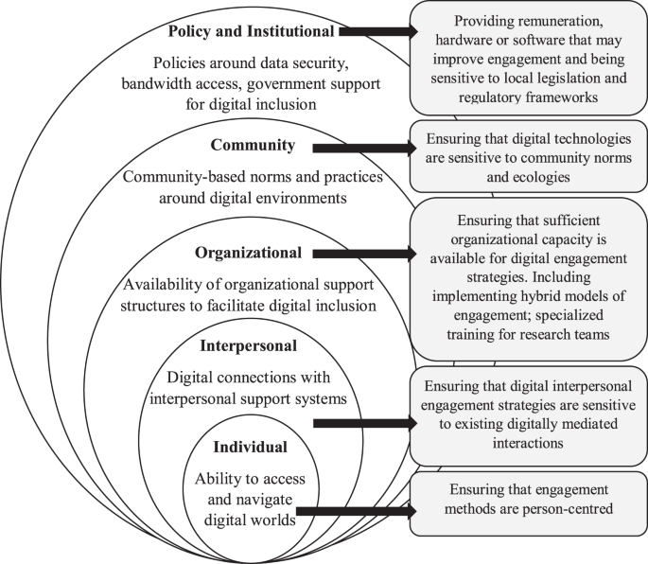

Slide 9
Can you think of any other groups?

Slide 11
Have you got any examples of digital exclusion?

Slide 12
Let’s hear from our experts

Slide 16
The end

