Slide 1

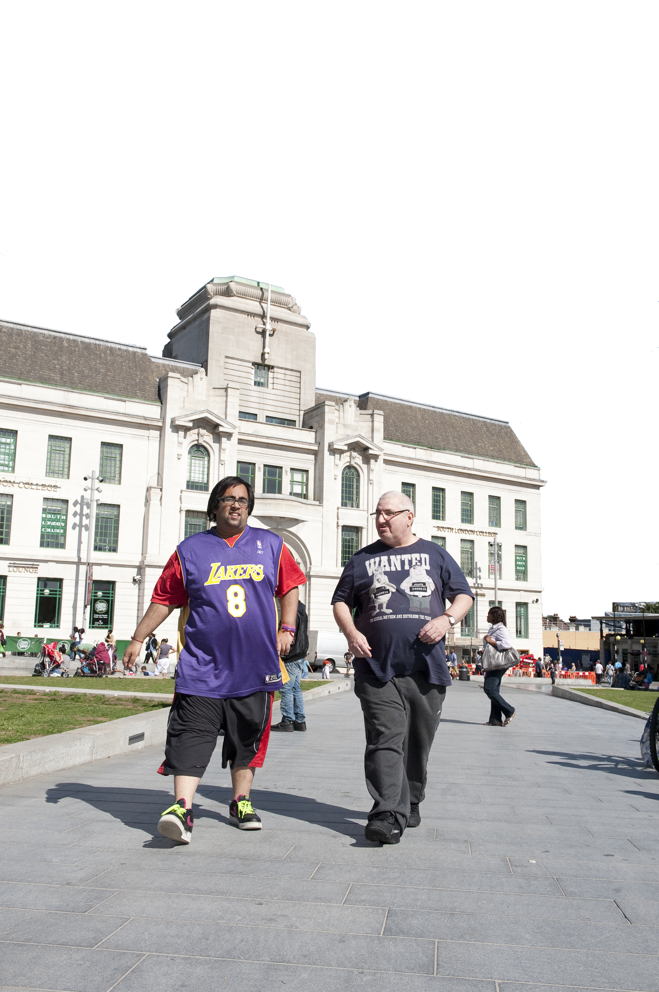


Restrictive Practice

Slide 2
What is restrictive practice?
Spend a couple of minute discussing this in pairs

Slide 3
Restrictive Practice
Planned or reactive acts on the part of other person(s) that restrict an individual’s movement, liberty and/or freedom to act independently in order to take immediate control of a dangerous situation where there is real possibility of harm to the person or others if no action is undertaken’ and ‘end or reduce significantly the danger to the person or others’, and ‘contain or limit the person’s freedom’.

Slide 4
Types of restrictive practice
1. Physical Restraint
2. Mechanical restraint
3. Chemical Restraint
4. Seclusion
5. Segregation

Slide 5
Seclusion
How do you define seclusion?
Are we allowed to seclude people at Atlas?

Slide 6
Seclusion
Seclusion refers to the supervised confinement and isolation of a patient, away from other patients, in an area which the patient is prevented from leaving, where it is of immediate necessity for the purpose of the containment of severe behavioural disturbance which is likely to cause harm to others (MHA Code of Practice, 2015)

Slide 7
Seclusion
This does not simply refer to purpose built seclusion rooms but to anywhere that the above definition is applied. This may be a patient’s bedroom, for example. In Oxleas, dedicated seclusion facilitates are available in our forensic services only.

Slide 8
Seclusion
What do we have to tell, what do we have to do and record?

Slide 9
Seclusion
The following practice should be recorded as seclusion
1. A patient is locked in a seclusion room
2. A patient is locked in a bedroom
3. A patient is placed alone in a room and prevented from leaving either by the door being locked, held shut or staff standing in the doorway preventing the patient from leaving.
4. Where a patient asks to be isolated from others and is then prevented from leaving the area in which they are isolated.

Slide 10
Seclusion
The following practice should not be recorded as seclusion
5. If a patient is being restrained by staff, they are not being secluded.
6. If a patient is asked to go to a particular area but is free to leave that area, they are not being secluded.

Slide 11
Discussion following a single incident of seclusion
Often an informal conversation with the patient or carer can be enough to stop a set of abusive behaviours. Any informal conversation should ideally be led by either the lead clinician or the team manager.
The discussion should
  Set out clearly what behaviours are inappropriate
  Explain the effect that they have on staff.
  Be clear that the behaviours must stop
  Be documented on RiO.
  Datix form updated for the action taken

Slide 12
Meeting following a two or more seclusions
If an informal discussion does not lead to a cessation of abusive or violent behaviour then a formal meeting can be held with the patient or carer.
The meeting should
Be led by the senior responsible clinician or a senior manager.
Clearly set out which behaviours are inappropriate
Explain the impact that they have on staff.
Be clear as to what actions will be taken if the behaviour continues
Be documented in RiO and reflected in the care plan
Be shared with the multi-disciplinary team
Datix form updated for the action taken

Slide 13
Discussion
In what circumstances do we think that the patient needs to move into a secure service?

Slide 14
Transfer of care
In extreme situations care of a patient may be transferred to another organisation if the trust feels that it is unable to manage the patient in question and guarantee the safety of staff. If you feel that a situation has reached such a stage you should be discussing the matter with your MDT who should then discuss this with your clinical director and the Medical Director.

Slide 15
Segregation
Segregation is nursing or caring for a person in enforced isolation, (excluding isolation to prevent the spread of infection), regardless of:
1. whether the procedures and requirements of the MHA code of practice 2015 for long term segregation are met, and/or
2. the user of services has periods of interaction with staff or peers

Slide 16
Segregation
Any situation in which a patient is in enforced isolation (excluding isolation to prevent the risk of infection) is to be recorded as segregation. See appendix 8 for examples.
The following practice should not be recorded as segregation
1. A patient is restrained and moved to the seclusion room
2. A patient is escorted to another ward to engage in therapeutic activities. He is the only patient using the facility and returns to the ward when he is ready.

Slide 17
When Flat 5 is being used – when does it become segregation?

Slide 18
Any other points?

Slide 19
Thank you
Any questions?

