Slide 1
Mental Health and
Advocacy
Steve Hardy

Slide 2


Slide 3
Types of advocacy
Self-advocate!
Advocacy For All, Lewisham Speaking Up
Independent Mental Health Advocacy
Independent Mental Capacity Advocacy
NHS Complaints Advocacy
Care Act Advocate.

Slide 4

How can an advocate help?
get what you are entitled to
get your point of view across
get the services that you need

Slide 5

Your advocate should…..
Be clear about what they can and can’t help you with
Tell you about what they have done on your behalf
Respect you and not judge you
Listen to you and talk through your options
Give you information to help you make decisions
Be free
Encourage you to speak for yourself

Slide 6
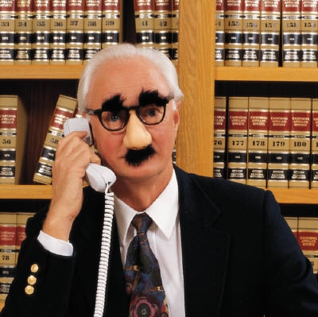
What shouldn’t an advocate do…..
Offer you counselling
Tell you what to do
Force their views or opinions on you
Do things on your behalf without asking you first

Slide 7
Remember..
It's your life
It's your body
Make your own decisions
Speak up
Be heard
Sometimes we all need support

