Slide 1
An examples
of real-life experience of mental health distress

Slide 2
Jack
A young autistic man who has learning disabilities
An energetic and fit young man
Speaks a few words, loves painting, cooking curries and cake and is always on the go!
Jack knows his own mind and knows exactly what he likes
His home where he lives with other autistic people and supported by an organisation

Slide 3
Jack
Then he started to become distressed
He started to need much less sleep
After about three weeks he returned to his usual self
Jack saw a psychiatrist, no medication was prescribed
A month later there were long periods of no energy and was sleeping far more
This was followed by an increased period of distress +++, self-harming, no sleep etc.
After a period of an inpatient stay he was diagnosed with bipolar and prescribed Lithium

Slide 5
Jack
Lithium had a limited affect on Jack and still experienced intermittent high/low periods – other mood stabilisers were tried without success
With seven periods of depression and mania over one year ‘treatment resistant rapid cycling bipolar’ was diagnosed
Extreme distress
Serious self harm and damage to property
Had his own flat and garden within the inpatient unit
Days without sleep
Some loss of skills
Losing weight……….
Never leave the unit
Very difficult to engage

Slide 6
Clozapine
Evidence to support ‘Clozapine’ for treatment resistant schizophrenia
Limited evidence for treatment of rapid …..
But ‘Clozapine’ comes with serious side effects and needs permanent monitoring via blood tests

Slide 7
Jack
Jack was able to have his blood taken
He was started slowly on Clozapine and all of his medication were titrated
Within two weeks we saw a different Jack
His family said they now have Jack back!

Slide 8
Clozapine – a catalyst for engagement
First time in months that he had stepped outside of the unit
Started painting for one minute and within a few months he had painted the whole garden!
Jack started to make 15 minute cakes, with six months he was cooking curry for everyone
He regularly used a sensory room
He went out of the hospital grounds for the first time in a year
Jack enjoyed cyclopark in Gravesend, shopping, swimming

Slide 10
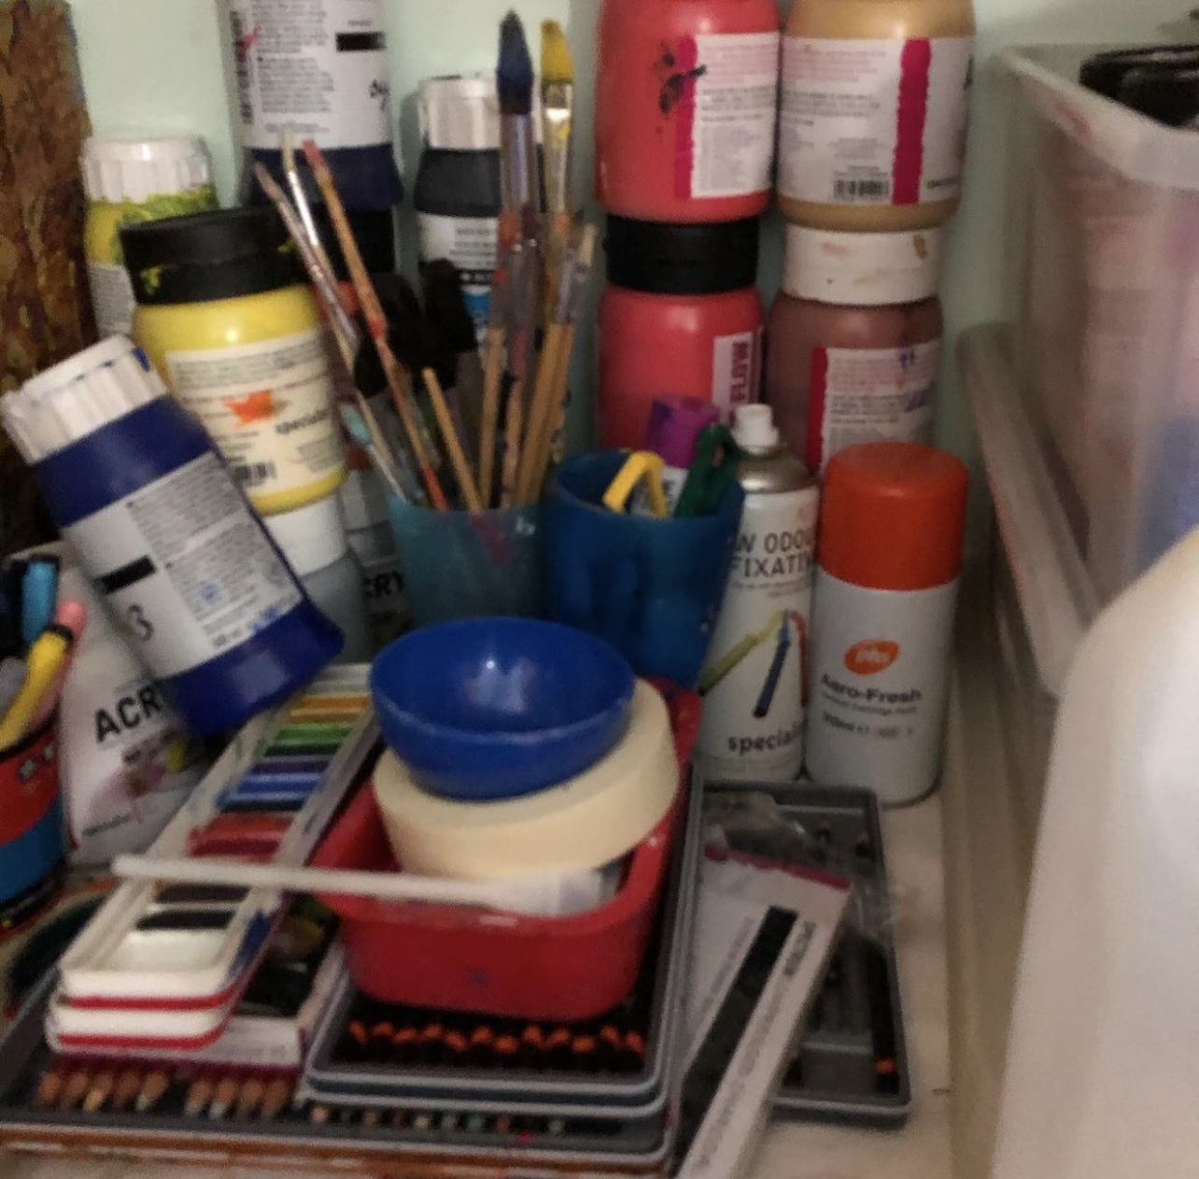

Slide 11
Jack
Jack was discharged to a home which is run by a charity that specializes in autism
He is doing so well and always puts a smile on your face!

Slide 12
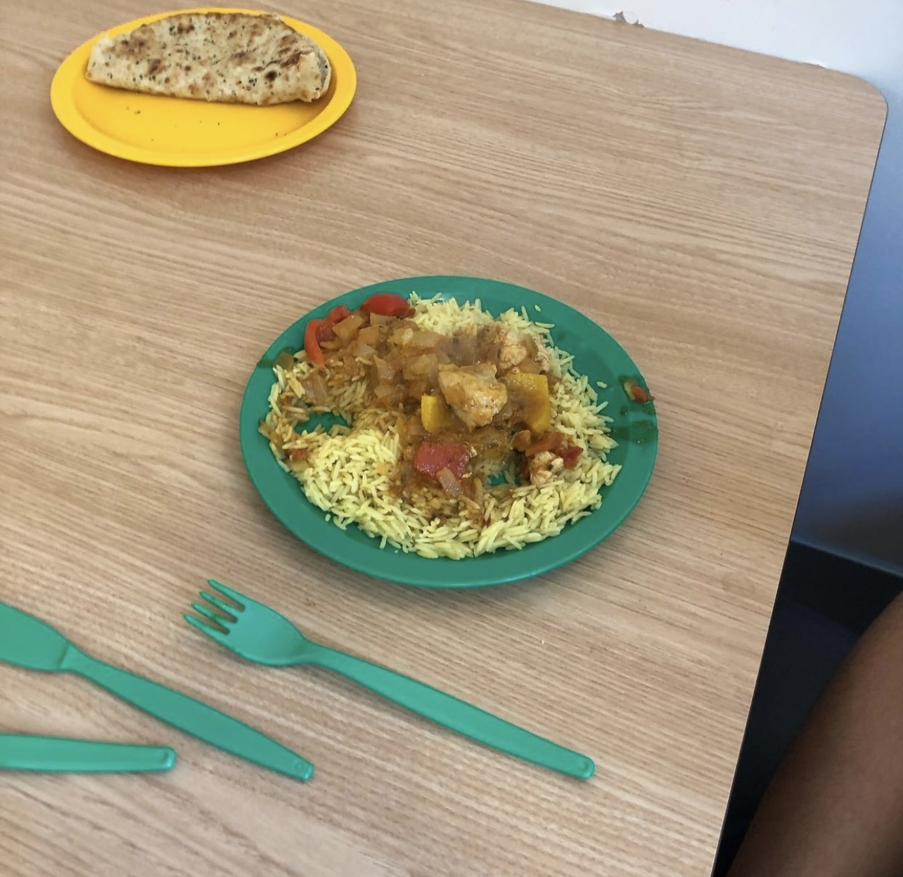

Slide 13
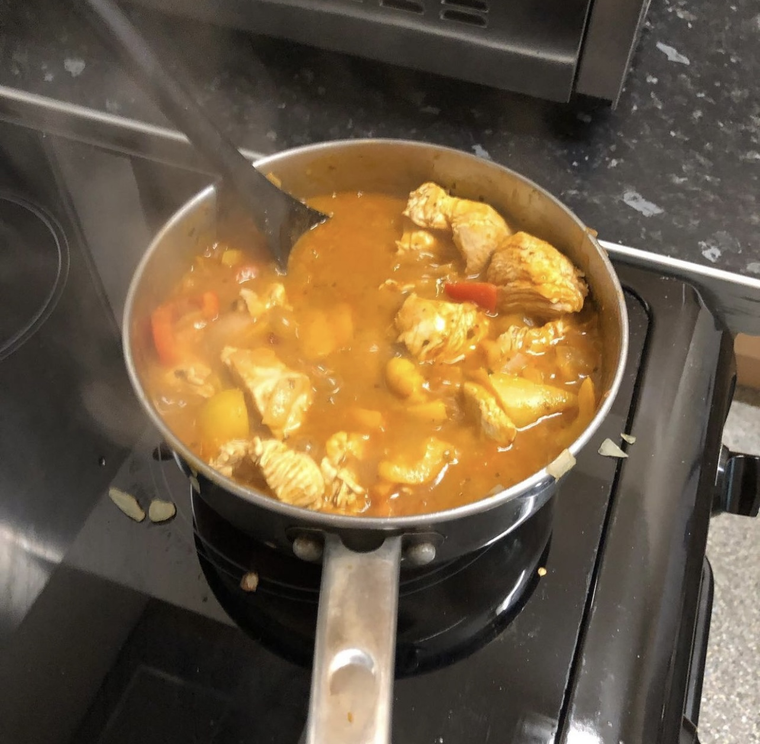

Slide 14
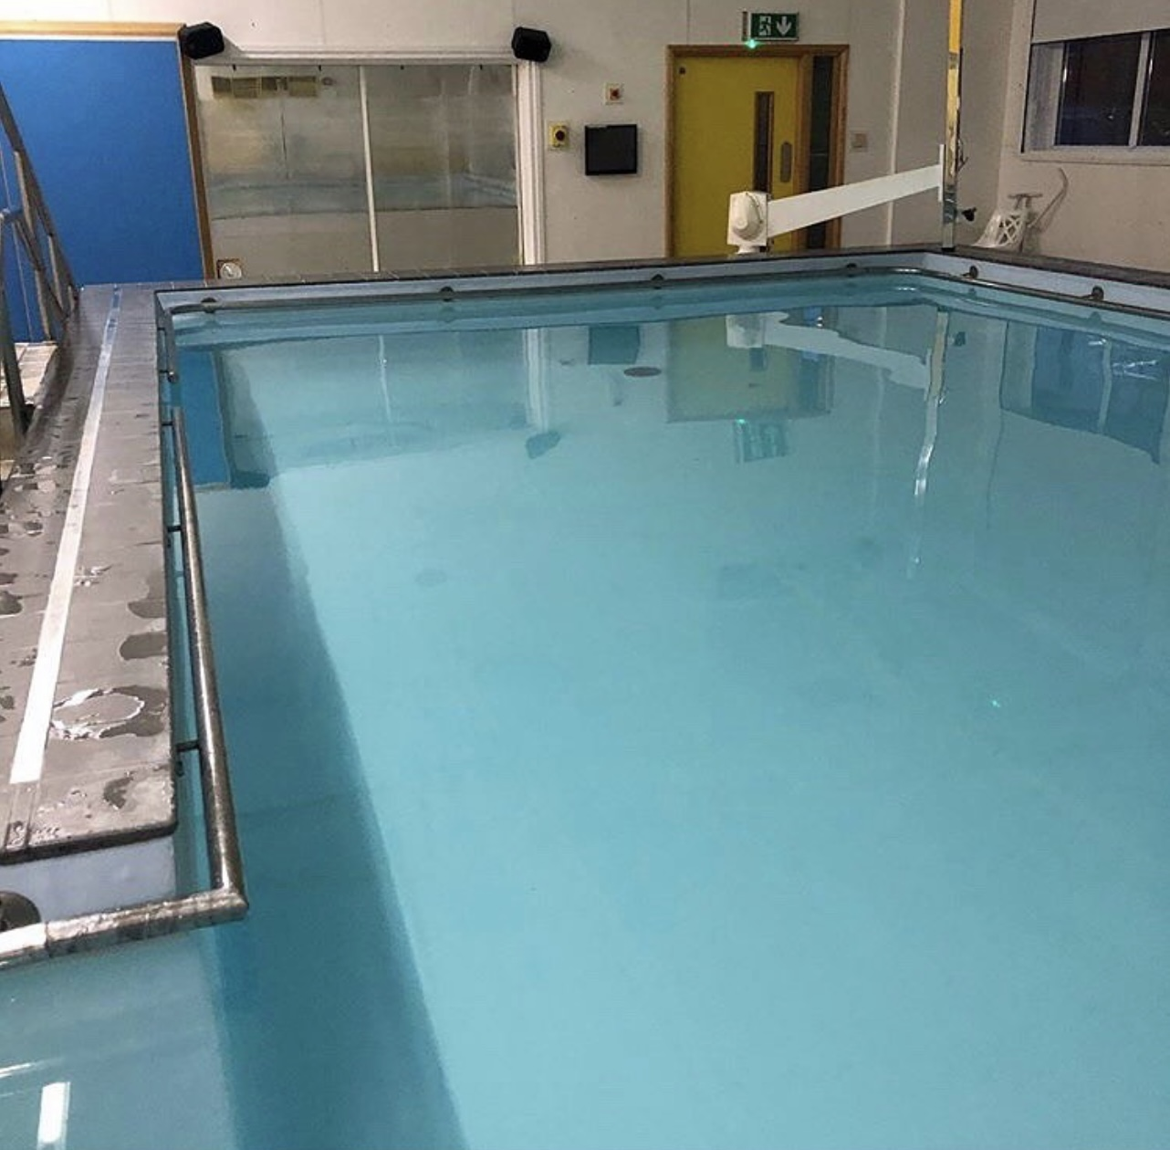

Slide 15
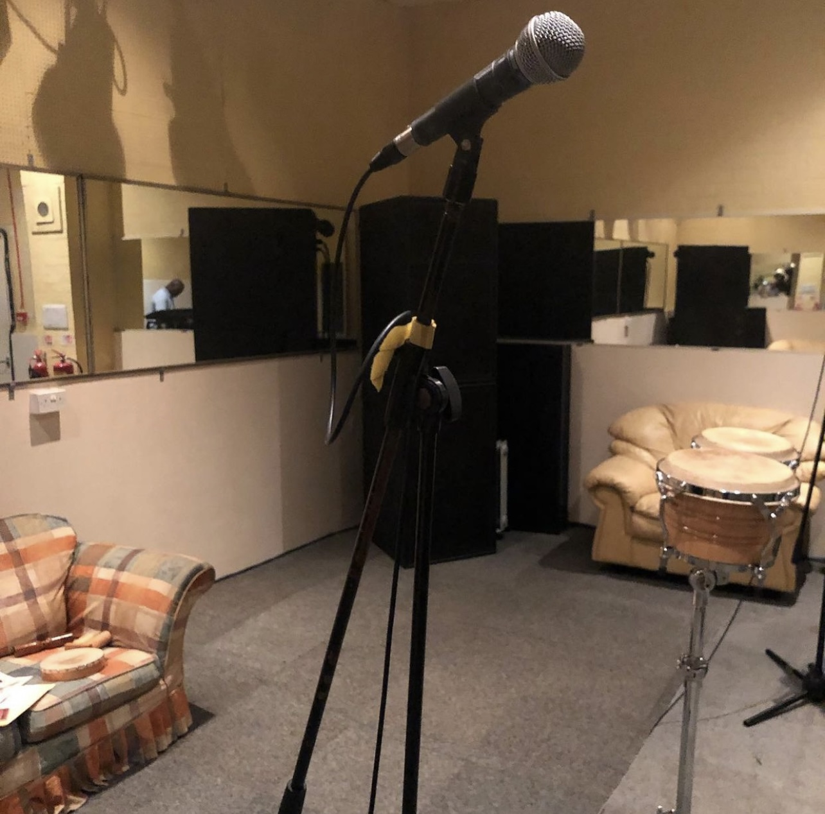

Slide 16
Interviews
We will conclude with two interviews with autistic people who have learning disabilities and share their thoughts on mental health

Slide 17
Mehmet
I am autistic
I have learning disabilities
I sometimes suffer with mental health
Because of covid
Because of being picked on and bullied
I deal with it by talking to my parents, cousins and ResearchNet
I go to see my GP if I feel down

Slide 18
Mehmet
I go out with one of my cousins, he is a man
He picks me up in his car
We go to a Turkish restaurant
The food is very good
Noise sometimes upset me
The storms really frightened me
I have another cousin who I speak to on the telephone
My family and ResearchNet are really good for my mental health

