Slide 1

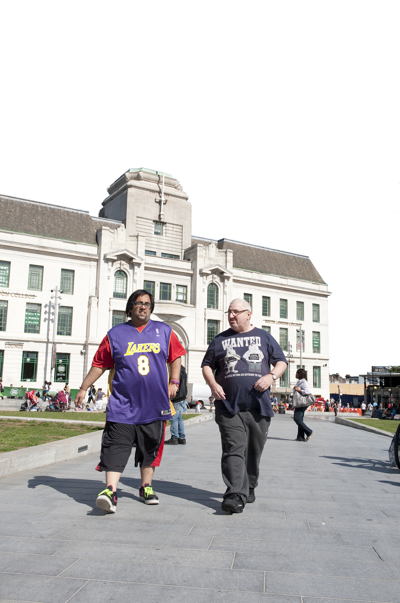


Service user involvement to coproduction
Or does it come naturally?
Peter Cronin
ResearchNet
CYUI? Team
Steve Hardy

Slide 2
This part of the presentation is by:
Peter Cronin, self-advocate, Lewisham Speaking Up
Steve Hardy, Practice Development Nurse, Oxleas NHS Foundation Trust

Slide 3
What we will be doing?
What is coproduction?
How you should do coproduction
Examples from
      Pete and Steve
      CYUI? Team
      Conclusion
      Then….
      An interview with ResearchNet!

Slide 5
What is coproduction?

Slide 6
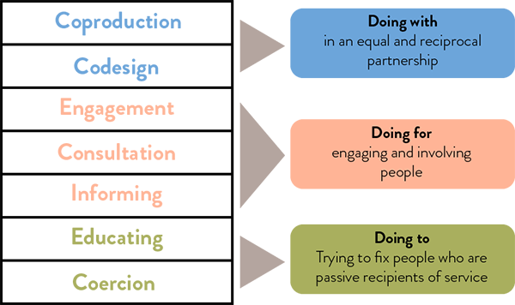
https://knowhow.ncvo.org.uk/

Slide 7


Slide 8


Slide 9
What do you understand by ‘coproduction’?
Equal partners
50/50
Be listened to and including my ideas
Being paid
Respect
Equal opportunities

Slide 10
Writing a book!

Slide 11
Writing chapters in books!

Slide 12
Making educational videos!

Slide 13
Completing pre-CQC inspections

Slide 14
Doing research!

Slide 15
Writing articles!

Slide 16

Showcasing the work of the Can you understand it? team
Oxleas’ Learning Disability Editorial Team

Slide 17
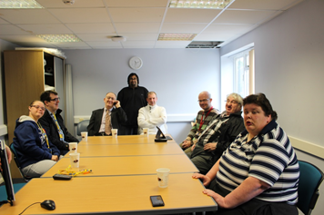
The Can you understand it? team
The team has been running for 11 years!!!
The team is made up of people with learning disabilities who use Oxleas’ services.
The team sadly said goodbye to John who passed away last year.

Slide 18
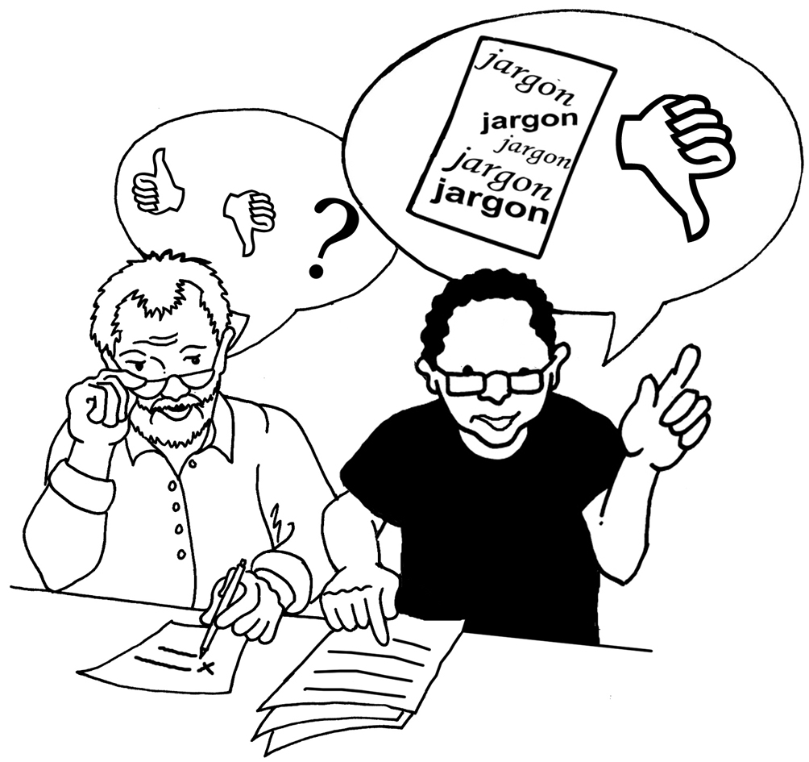
What do the team do?
The team are an ‘editorial group’.
This means that they look at all the Easy Read information written by staff.
The team tell staff how to make the information better using easier words and clearer pictures.

Slide 19
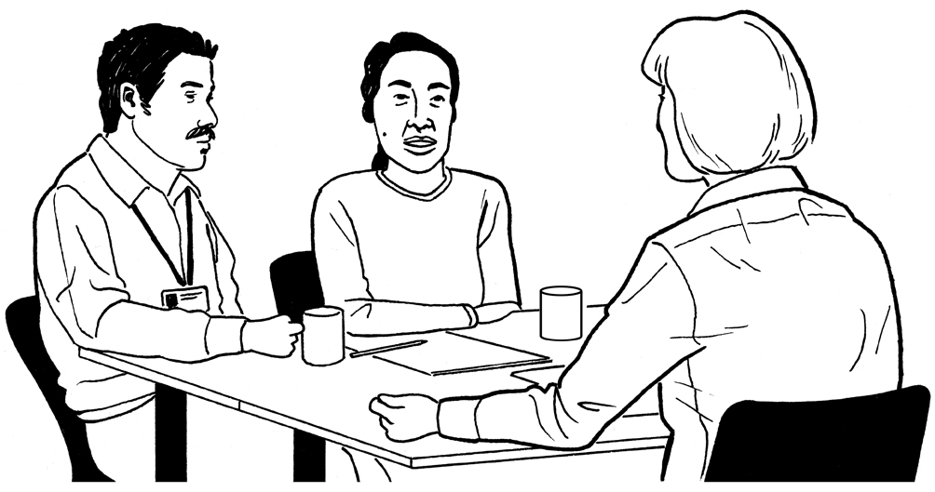
In 11 years the team have looked at about 70 leaflets!
The team get paid for their work
The team also sit on interview panels

Slide 20
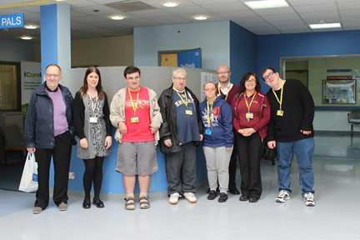
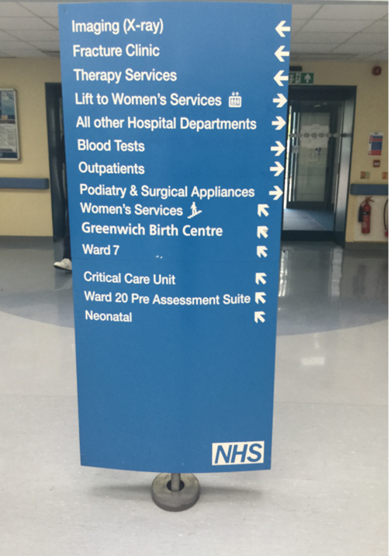
Other projects
The team were asked to look at the signs in Queen Elizabeth Hospital a couple of years ago
They found:
The signs in reception were confusing.
Sometimes the arrows were pointing the wrong way.
The writing on some signs was too small.
They gave ideas to make the signs better

Slide 21
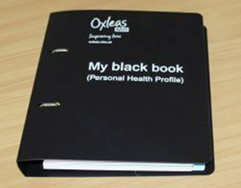
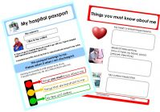
Videos the team have made
Videos are useful to explain things
They have taken part in making videos about
The Black Book
The Hospital Passport

Slide 22
Working with ResearchNet groups
The team have worked with the ResearchNet groups to produce
‘Keep safe’ leaflet
Top tips when communicating with people with learning disabilities
The Bill of Rights

Slide 23
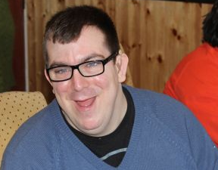
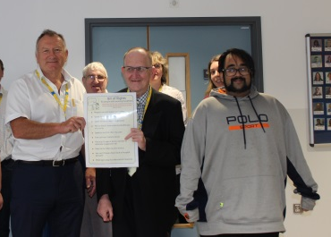
About the team!!
Team member, James describes his work as ‘ I love the group. I like discussing leaflets , sharing ideas and supporting each other. I have to work hard in the group. We also get a chance to share our problems and we get on with each other.’
Andy Trotter (Oxleas’ Chair)who visited said:
‘We had a really good visit and were very impressed with the enthusiasm and understanding of the service users, and the care and professionalism of our ALD staff.’

Slide 24
Gratitude is our attitude!

Slide 25
Thank you
Now here’s
ResearchNet!

