Slide 1
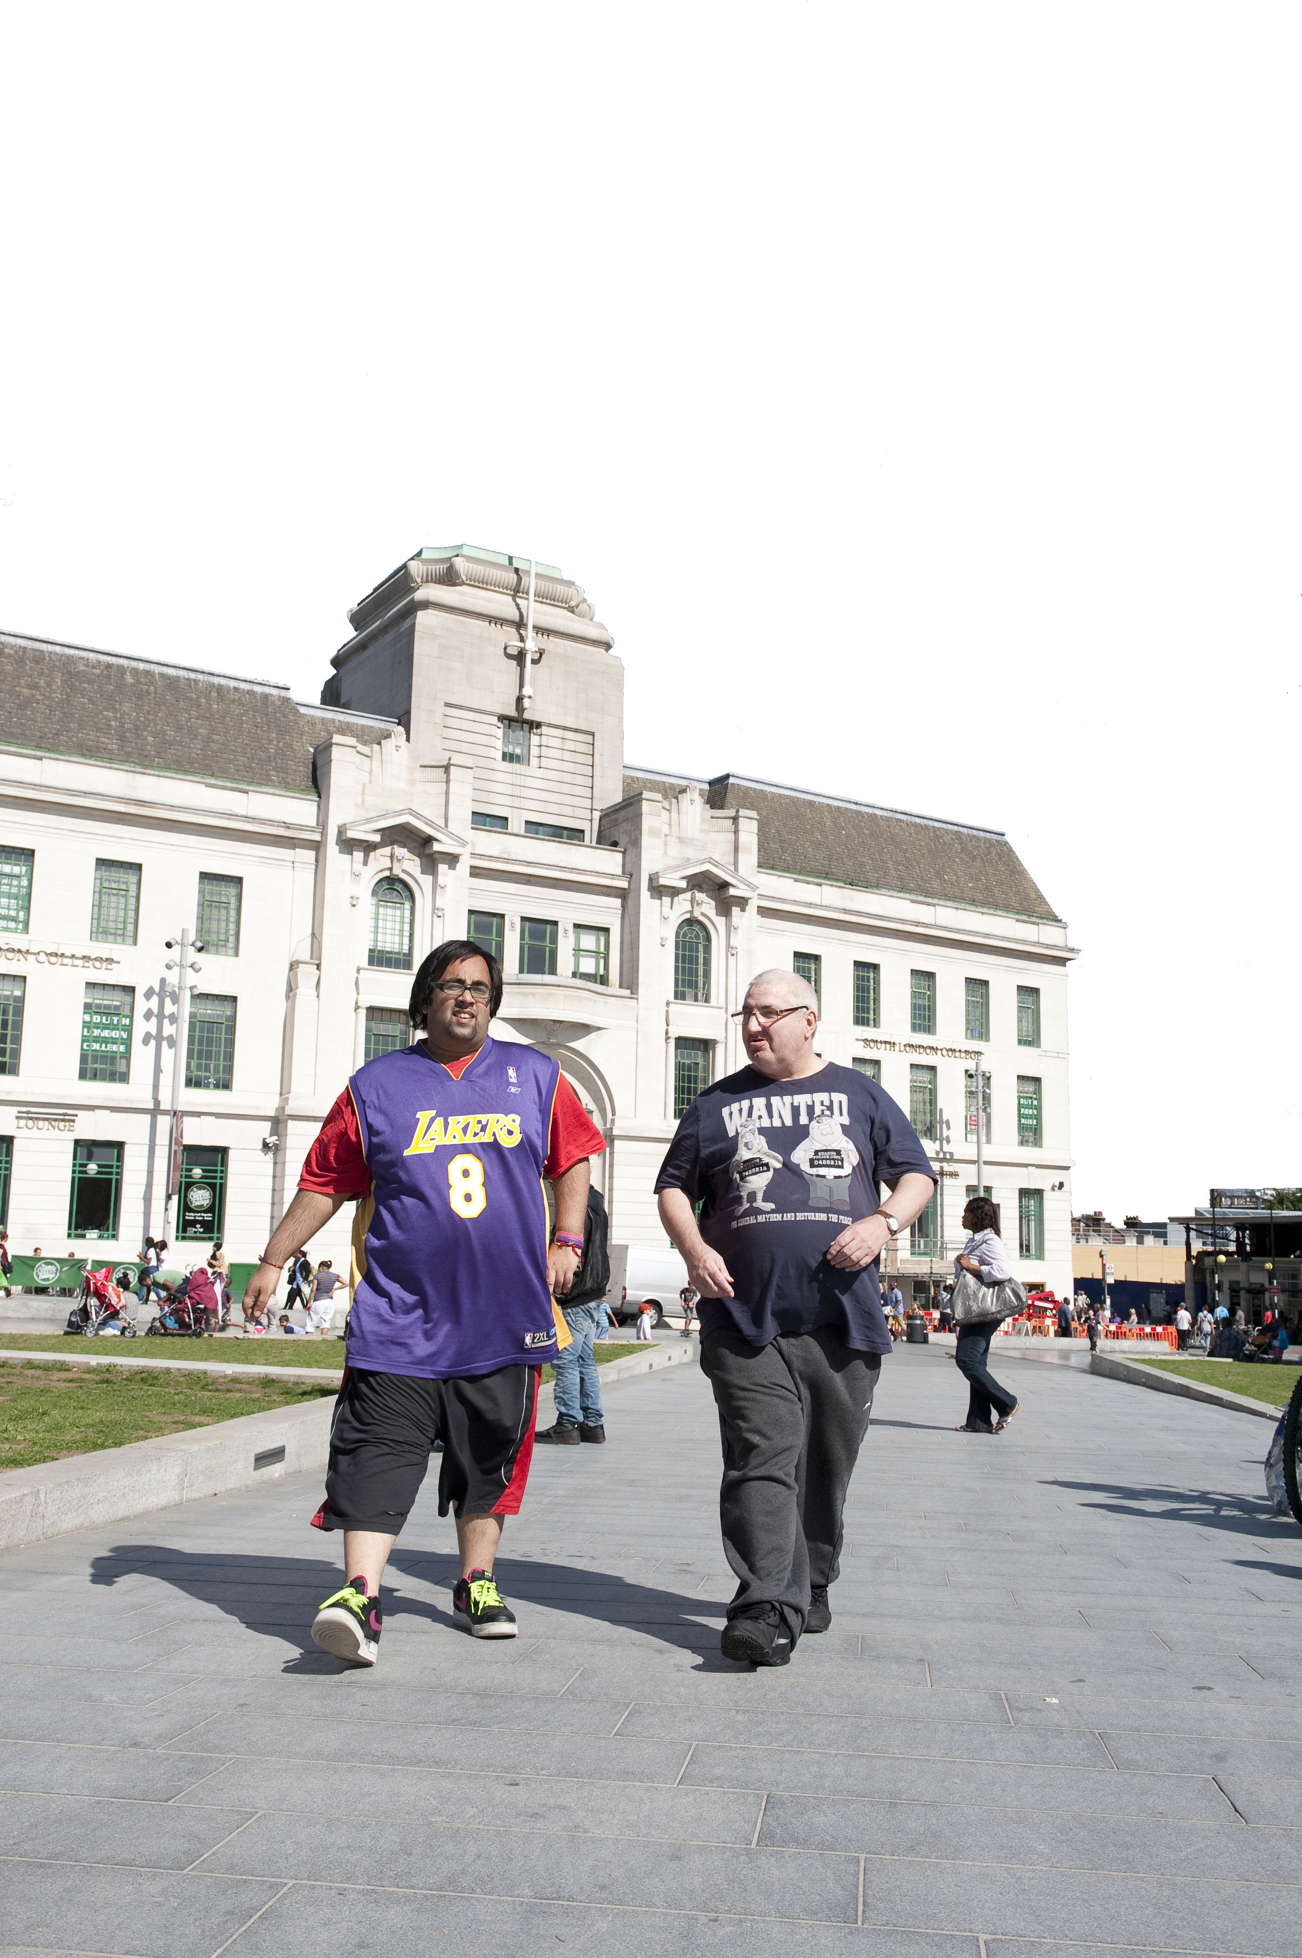

Slide 2
A presentation by …………………
Peter Cronin – self advocate and MP for Employment, Lewisham Speaking up
Steve Hardy, Practice Development Nurse, Oxleas NHS Foundation Trust

Slide 3
Why do we talk about human rights?
Doesn’t everyone have human rights in the UK?

Slide 4
Human Rights Act 1998
Was intended to create ‘a culture of respect for human rights across the UK’
Framework to support public officials design and deliver rights-respecting services and lead to better outcomes for people using those services.
Human rights can be a useful lever for change
Helen Wildbore, British Institute of Human Rights

Slide 5
What are human rights?
It’s about
Your freedom
Treated with respect
Treated with dignity
Treated fairly
Speak up, being heard
Control over your own life
Making your own decisions
These are basic rights that everyone can expect

Slide 7
Do people with learning disabilities have the same human rights as you?

Slide 8
Article 12 – Right to marry and start a family
Me and my wife wanted to get married. We booked the church, the reception and honeymoon. The home manager cancelled went to see the vicar behind our back and cancelled it.

Slide 9
Can anyone stop you from getting married?
What if you had a learning disability?

Slide 10
Article 3: Freedom from torture and inhuman or degrading treatment
It is still upsetting to watch Winterbourne Views. It’s really emotional and why did they treat people with learning disabilities like they are criminals. Even worse than criminals.

Slide 11
Winterbourne View
Whorlton Hall
Muckamore Abbey Hospital
Mendip House

Slide 12
Could this happen to you?
What if you had a learning disability?

Slide 13
Protocol 1. Article 3 – Right to participate in free elections
I’ve wanted to vote since I was 18. I tried so many times to get registered but I need the help of support workers. It wasn’t until the 2016 election that Steve supported me to register and vote.

Slide 14
Are you able to vote?
What if you had a learning disability?

Slide 15
Article 10 – Right to freedom of expression
Peter has a voice
He is heard, listened to and action is taken
Lewisham Speaking Up helps with this
Representative for employment
Have addressed the Major of London, Councillors for Lewisham
Have seen great progress in recent years
The Learning Disability Senate
Learning Disability England
Rightful Lives
The list goes on….

Slide 16
Life is changing for people with learning disabilities
Progress is being made

Slide 17
Who’s valuing who? I am human too!

Slide 18
Article 2: Right for life - Campaigning for a better life
May 2018 was a bad month for us
Can you guess what we are talking about?

Slide 19
LeDeR Report
Action was needed!

Slide 21
What we did
We started a petition
We run this for 2 weeks
We posted it on:
FaceBook
Twitter
Email
We gave talks to advocacy groups
650!

Slide 22
Jeremy Hunt never replied
Does this surprise you?
Sir Simon Stevens, CEO of the NHS and Ray James CBE, National Learning Disability Director both replied personally
We were invited to meet up with Ray

Slide 23
Our meeting with Ray James
The NHS Long Term Plan
Mandatory training on autism and learning disability for NHS staff
Inclusion
Involvement
He was a lovely man!

Slide 24
The Right Honourable …….
What did this man do when asked a question about LeDeR in parliament?
Does he have respect for us?

Slide 25
What do we expect?

Slide 26
What we have learnt about campaigning?
Have a clear vision
Become an expert
Get support
Know your opponents
Plan for success
Get your message across
Never give up!
Know the difference between rudeness and assertiveness

Slide 28
Thank you!

